Slide 1

Add Title Here

Slide 2
Elevator Pitch/Brief Course Preview
Spend 2-5 minutes getting the audience excited!
Hook the audience right from the start!
Why do you think this course matters for the audience?
What will you cover (at a high level) and what will they be able to do at the end of the course?
Get them excited right away about the materials! If you can do a quick demo or start with an example it will get them thinking right away.

Slide 3



Meet your Instructor
Spend no more than 2 minutes here
Introduce yourself!
Learners want to hear your unique
perspectives and experiences
Being authentic and friendly builds connection between you and the audience
image: Flaticon.com

Slide 4
Course schedule
Session 1
Let attendees know what they’ll be doing and learning in this course
It can help orient them and primes them to learn something new

Slide 5
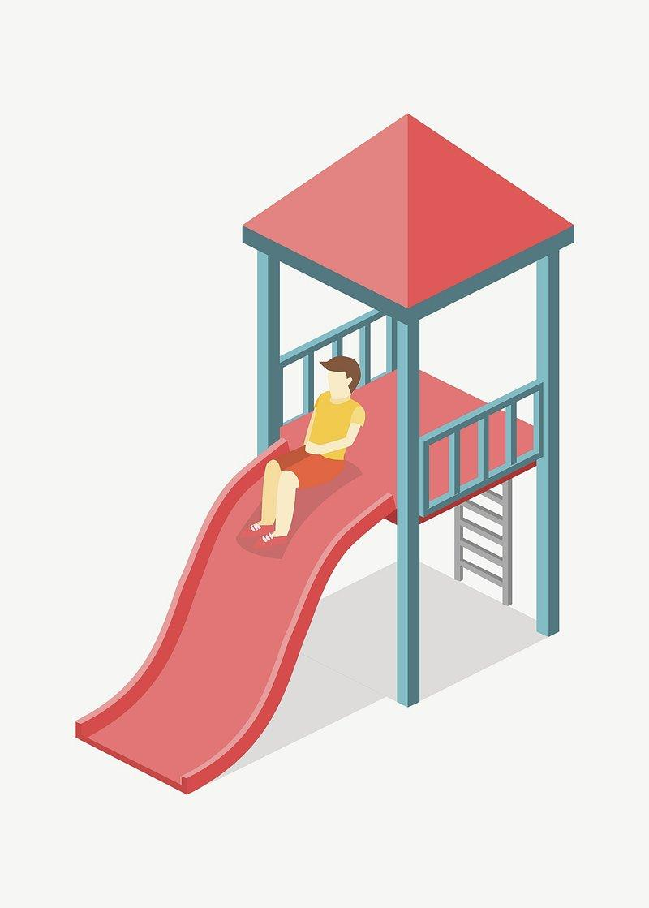
What makes an effective slide?
Less is more. Keep your bullet points and graphics simple and clear. Bold important terms and animate bullet points to help attendees follow your presentation
Too much information for one slide? Break it out into multiple slides.
Real-world examples and case studies help learners contextualize and retain new information.

Slide 6
Exercise
If you screen share during your exercise attendees will still be able to see the slide deck. Including some brief instructions or information to reference during the exercise can be helpful.
Step one
Step two
What is the goal of the exercise?

Slide 7
Poll: What will you ask attendees?
Polls are a great way to connect with attendees! You can ask them about their opinions or experience level, and everyone will see a breakdown of responses. We find that 1-3 poll questions per hour is best.
Poll answer 1
Poll answer 2
Poll answer 3
Notes:
They can be radio button or multiple answer. Your Event Producer will create polls for all questions marked “Poll” into ON24 for you when they load your slides.

Slide 8

Pulse Check
These are a way to quickly check in with attendees. Ask them a simple yes or no question, and the platform will prompt them to press “thumbs up” or “thumbs down”. E.g.
Does everyone have their Colab environment ready?
Are you clear on the key architectural differences between our three models?
Do you feel confident about implementing SLMs in your own projects?

Slide 9
Discussion Question
What should attendees think about? Ask a prompt question that attendees can answer in the group chat.

Slide 10
Q&A
Notes:
You will be able to see questions as they come in. Some instructors like to include this slide as a visual reminder to check the Q&A widget, but it’s not required.

Slide 11
Break
Notes:
Breaks are flexible in On24. Added to the end of your deck will be 5 minute, 7 minute, 10 minute, and 15 minute timers that you will be able to push to the audience whenever you want. Some presenters like to include this break slide as a visual reminder, but it’s not required.

Slide 12
Takeaways
What books, courses, etc. would you recommend attendees try next?
Do you have any other live courses coming up?
What resources are you sharing with them?
Including your social media handles or upcoming work can be a nice way to connect with attendees

Slide 13


